Slide 1



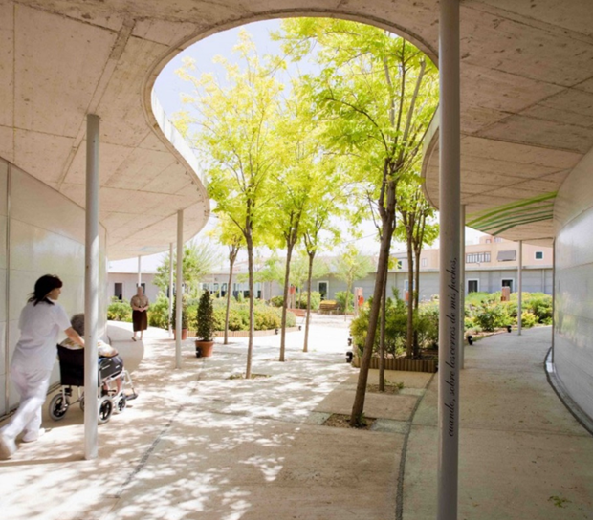
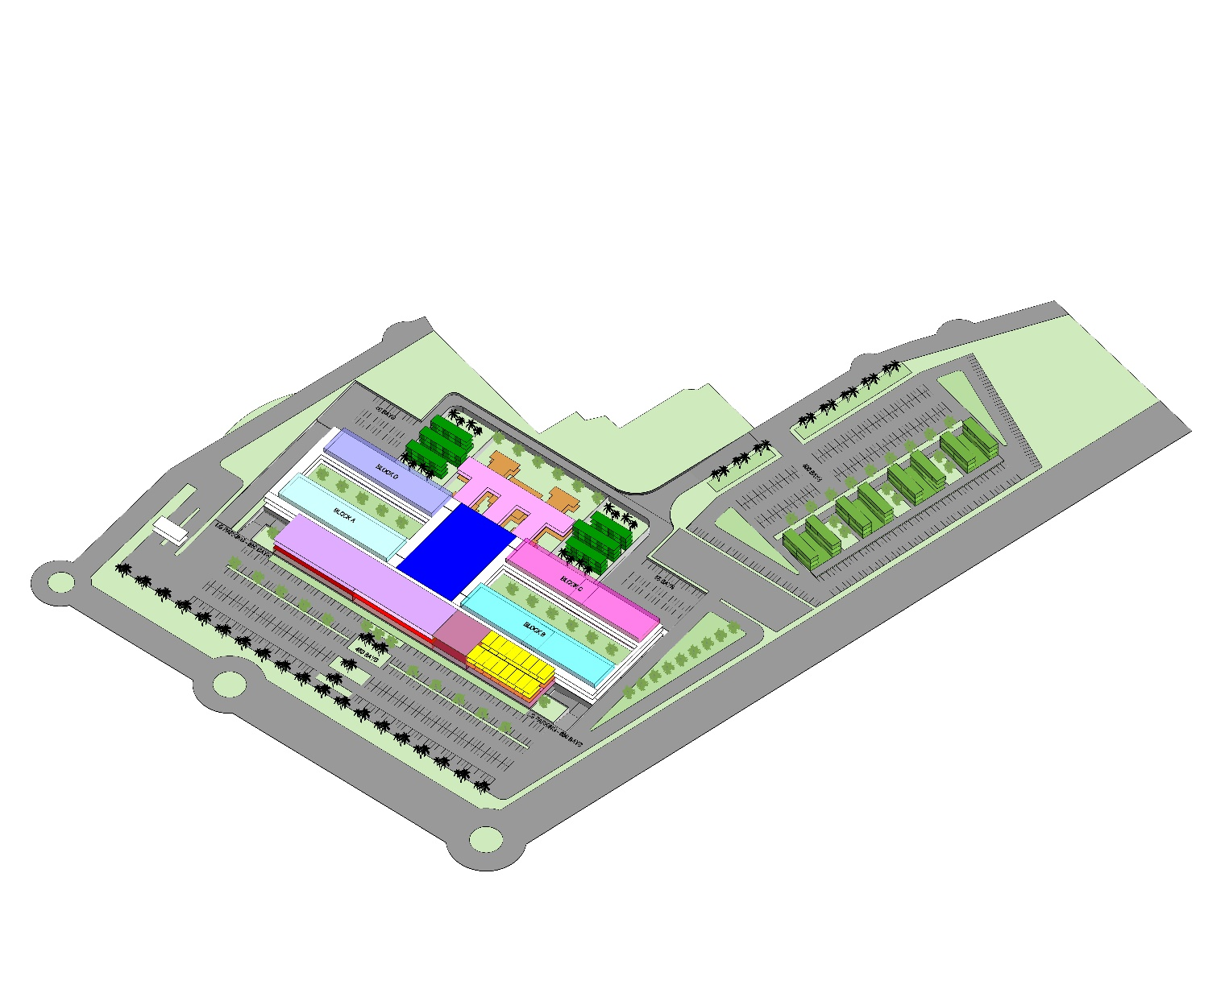
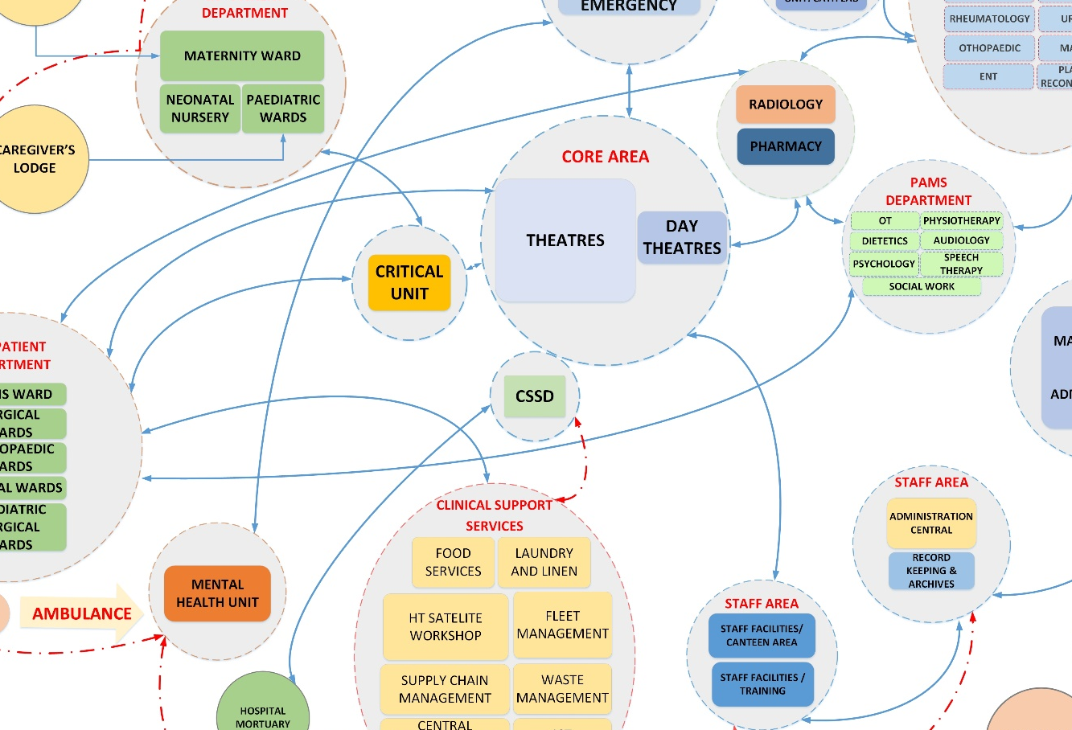
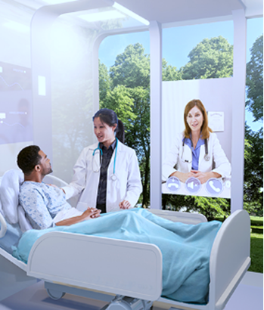
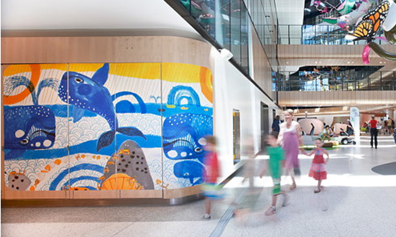
NEW TERTIARY HOSPITAL IN NORTHERN KWAZULU-NATAL
CLARIFICATION MEETING FOR THE PROCUREMENT OF CONSULTANTS
PMO Lead: Bongi Gcaba
Project Management Office: Priority Projects
17 July 2024
GROWING KWAZULU-NATAL TOGETHER
Notes:
BG Start

Slide 2
CONTENT
Project Background
Supply Chain Management
Scope of Works
Quality Management
Pricing Data
Evaluation Criteria
Planning and Programming
Questions
Concluding Remarks

Slide 3
BACKGROUND
Strategic planning at Mkuze on 12-13 October 2019
Need to improve access to specialized health care in KwaZulu-Natal
Budget speech on 5 June 2020, committed to:
  a new tertiary hospital and
  regionalization of four district hospitals
Primary benefits:
  Reduce long travel distances to access services by rural communities
  Reduce high costs of interfacility transportation of patients
  Reduce operational cost of the specialized health services.
  Budget speech on 21 May 2021 - Assessments underway on regionalization
PMO established to accelerate project planning on 06 April 2022
Budget speech on 10 May 2022 - Department was proceeding with planning
Steering Committee to oversee projects established on 11 October 2022
Strategy Planned
Stakeholders informed
Benefits communicated
Progress reported

Slide 4
PROBLEM STATEMENT
The project seeks to resolve the following main challenges:
Long travel distances for patients and their loved ones;
Current hospitals in Empangeni are not dedicated Tertiary Hospitals resulting in poor patient care;
Burden on Planned Patient Transport (PPT);
Backlog of patients needing tertiary services; and
Delayed access to medical care for emergency cases.

Slide 5
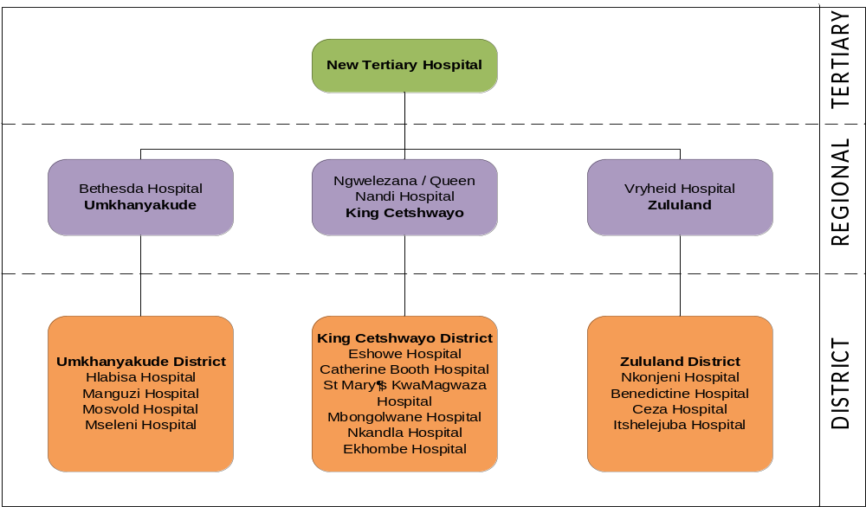
FUTURE STATE
Future referral pathway

Slide 6

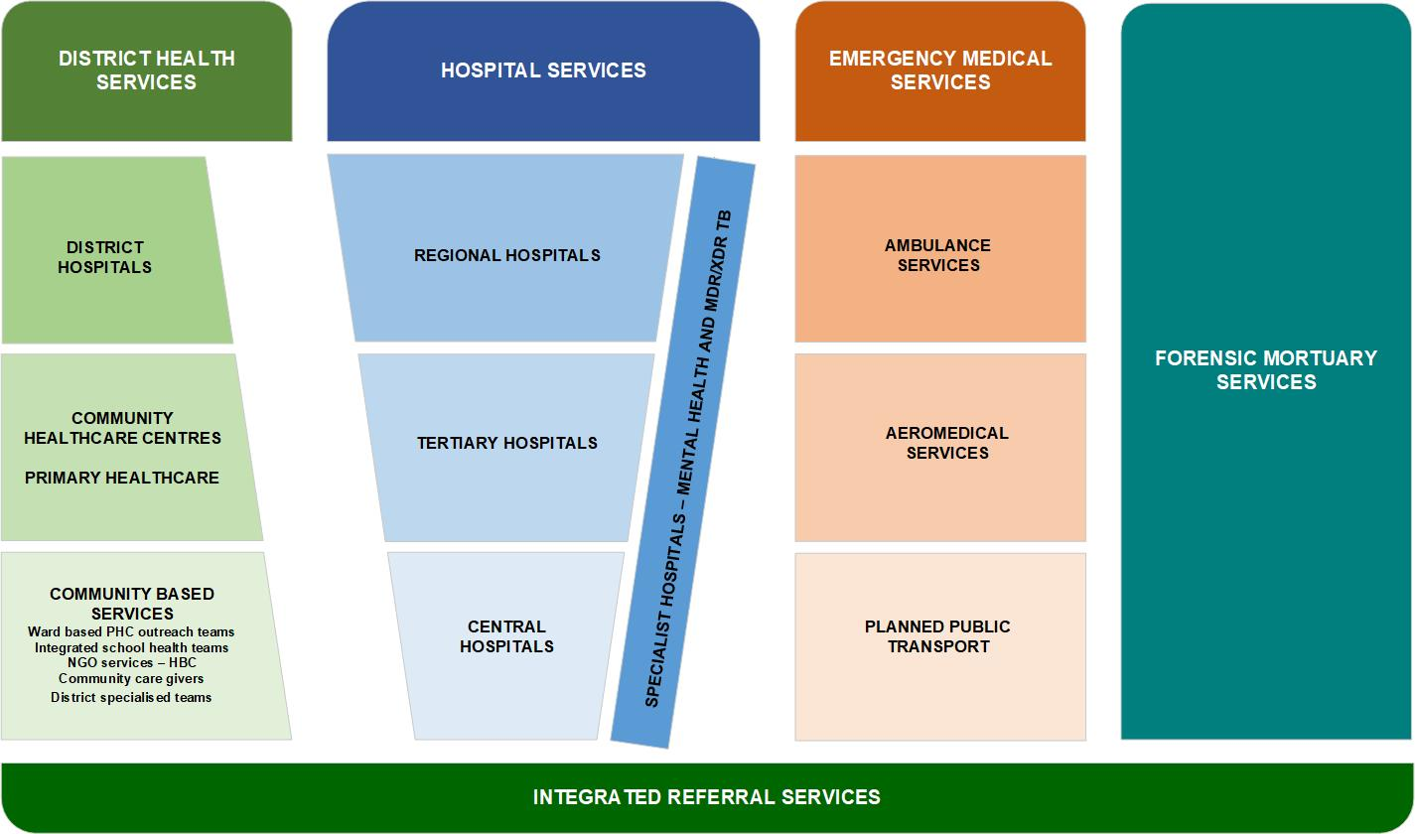
GROWING KWAZULU-NATAL TOGETHER
KZN PUBLIC HEALTH SYSTEM
Diagram adapted from South African health system in the Referral Policy for South African Health Services and Referral Implementation Guidelines
(National Department of Health August 2020)

Slide 7
GROWING KWAZULU-NATAL TOGETHER
PROJECT OBJECTIVES
Business / Clinical Objectives
Improve access to T1 level of healthcare;
Reduce burden on Planned Patient Transport (PPT);
Reduce burden and backlog of patients at tertiary hospitals in uMgungundlovu and eThekwini districts;
Improve quality of care of patients by treating patients closer to their place of residence;
Early access to tertiary services;
Allow Inkosi Albert Luthuli Central Hospital (IALCH) to develop T2 (Central Referral Services) and T3 services (National Referral Services);
Compliance to applicable norms, standards, specifications, processes and procedures throughout the project life cycle; and
Promotion of best practice in project implementation and public healthcare by showcasing the project and providing education to community and other interested parties.

Slide 8
GROWING KWAZULU-NATAL TOGETHER
PROJECT OBJECTIVES
Social and Economic Objectives
Consideration of social and cultural identity of the local community;
Job creation, training opportunities, development and opportunities to local businesses;
Empowerment of departmental staff; and
Empowerment of women, youth and persons with disabilities.

Slide 9
GROWING KWAZULU-NATAL TOGETHER
PROJECT OBJECTIVES
Project Management Objectives
Development of a quality project proposal for acceptance and approval by funding authorities;
Acquisition of a suitable site for the development;
Appointment of experienced and competent internal project team personnel;
Ensure due diligence in the appointment of consultants, contractors and subcontractors;
Development of a cohesive team to successfully lead the project from project initiation to close-out;
Effective and efficient project governance and its support systems (i.e. efficient project approval processes e.g. design, payment and variation order approvals);
Development of an innovative design that gives pride and unique identity to the people of northern KwaZulu-Natal; and
Effective communication and management of stakeholders in terms of Batho Pele principles and consideration of cultural context.

Slide 10
Package of Services
GROWING KWAZULU-NATAL TOGETHER
Table 1 - Approved bed numbers
Discipline | Bed Number | Percentage of total | Beds not counted
Anaesthetics
Critical Care | 32 | 6%
Emergency Medicine/Trauma |  |  | 16
Radiology
Obstetrics & Gynaecology | 53 | 10% | 7
Paediatric Services | 68 | 12%
Paediatric Surgery | 15 | 3%
Internal Medicine | 105 | 19% | 28
Oncology | 32 | 6% | 30
Nuclear Medicine
Surgery | 45 | 8% | 16
Cardiothoracic Surgery | 10 | 2%
Burns Service | 15 | 3%
Neurosurgery | 10 | 2%
Maxillofacial Surgery | 10 | 2%
Ophthalmology | 14 | 3%
Otorhinolaryngology (ENT) | 15 | 3%
Plastic and Reconstructive Surgery | 10 | 2%
Urology | 16 | 3%
Vascular Surgery | 10 | 2%
Orthopaedic Surgery | 45 | 8%
Psychiatry | 45 | 8% | 6
TOTAL | 550 |  | 103

Slide 11
GROWING KWAZULU-NATAL TOGETHER
SITE DEVELOPMENT STUDIES
Mental Health
Chemo & Renal Dialysis
Entry 1
Paediatrics & Neonatal
Critical Care & Ortho
Entry 2
Staff Accommodation
Maternity & Medical wards
Surgical wards
Surgical wards
Emergency & Admissions
Admin and Teaching Spaces
Theatres & CSSD
Pharmacy
Laboratory and Blood bank
Outpatient Department

Slide 12
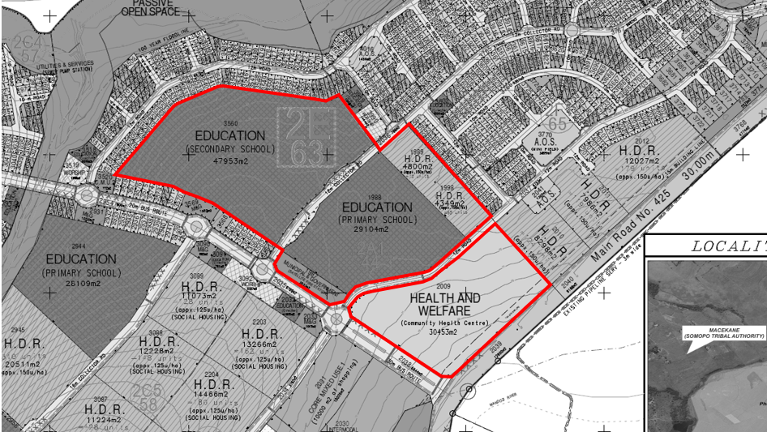
GROWING KWAZULU-NATAL TOGETHER
LAND ACQUISITION
NEW TERTIARY HOSPITAL 9Ha
NEW PHC 3Ha

Slide 13
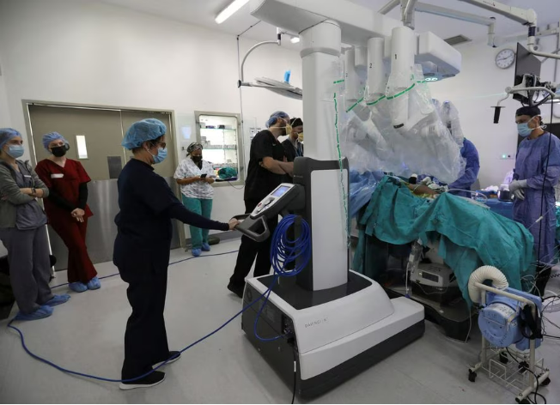
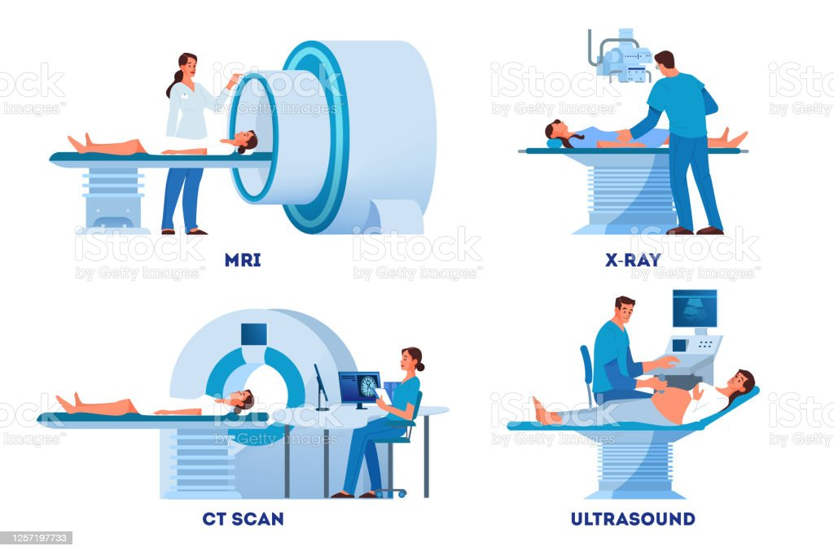
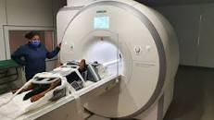
HEALTH TECHNOLOGY SERVICES
GROWING KWAZULU-NATAL TOGETHER
There are important departments that require a high cost of Health Technology. These departments are as follows:
Clinical Facilities
Anaesthetics department
Critical Care department
Radiology department which includes imaging services such as X-rays, MRIs, and CT scans.
Oncology
Emergency Medicine
Internal Medicine
Staff Facilities
Food Services
ICT Department
Nurse Clinical Training

Slide 14
EXCLUSIONS
GROWING KWAZULU-NATAL TOGETHER
This project does not provide on-site residential accommodation on behalf of its partners i.e., UKZN, SANBS, NHLS, etc.
This project does not provide for “fit out” of NHLS and SANBS facilities.
All bulk services such as water and sanitation, electricity, storm water and access roads are to be provided by responsible authorities and therefore not budgeted for under this project. However backup supply and alternative solution form part of this project.
This project excludes Operations and Maintenance activities. They have not been budgeted for under this project.

Slide 15
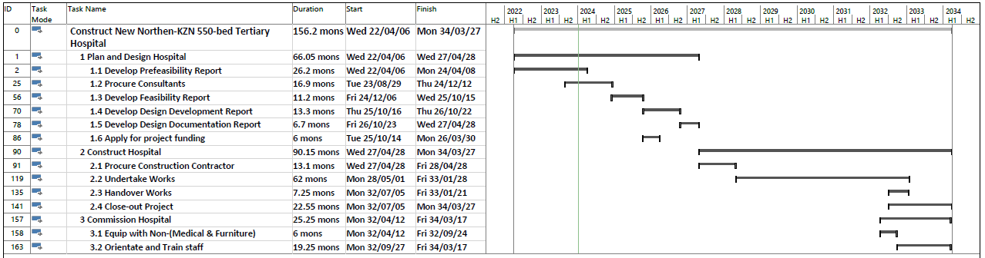
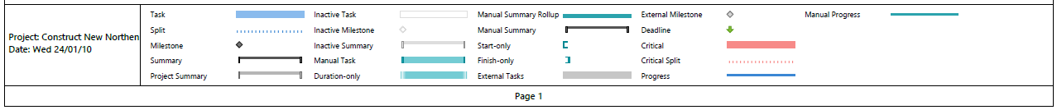
GROWING KWAZULU-NATAL TOGETHER
PROJECT SCHEDULE
Approve Business Case - KZNDOH
Feb 28
Approve Prefeasibility Report
Apr 08
Approve Handover / Record of Information Report
Jan 21
Approve Project Charter
May 15
Approve Design Development Report
Oct 20
Approve Clinical Brief - KZNDOH
Jul 31
Approve Concept and Feasibility Reports
Oct 13
Start Construction
May 12
Finish Construction
Jul 02
Approve Close-out Report
Dec 23
Start
Apr 06
2023
2024
2025
2026
2027
2028
2029
2030
2031
2032
2033
2034
Finish
Mar 27
Approve Requirements Document
Sep 12
Issue a Purchase Order (PG7)
Dec 05
Approve Project proposal for funding
Mar 30
Issue Final Completion Certificate
Jun 03
Establish PMO
Apr 06
Approve Business Case - NDOH
Jul 03
Approve Design Documentation Report
Apr 26
Complete equipping for commissioning
Sep 24
Complete the training of officials
Mar 17
Approve Clinical Brief - NDoH
Sep 28 - Jan 19
Notes:
PC Start

Slide 16
GROWING KWAZULU-NATAL TOGETHER
PROJECT PROCUREMENT
Design by Employer procurement strategy
Fixed Price Bill of Quantities pricing strategy for the project
Hybrid system for appointment of consultants – appointment of 3 consortia made up of the following teams:
    Project Manager, Quantity Surveyor and Health and Safety
    Architect, Civil Engineer and Structural Engineer
    Mechanical Engineer, Electrical Engineer and Electronic Engineer
CIDB Professional Services Contract and latest JBCC Building contract to be utilised
Empowerment of HDG and local labour
Implementation of the CIDB Build Programme

Slide 17
GROWING KWAZULU-NATAL TOGETHER
SUPPLY CHAIN MANAGEMENT
General Information
-Compulsory briefing
-Filling of attendance register
-Site Inspection Certificate
-Enquires
Amendments
- Amendments proceedings
Closing of Bid
Bid Documentation (including signing of offer)
Fraud
Contact Details

Slide 18
GROWING KWAZULU-NATAL TOGETHER
SCOPE OF WORK
Scope of services for each professional services is to be understood clearly
Consultation throughout stages with the following departments is required:
• DOH District
• DOH Head Office
• DOH Clinical Services
• National DOH
• Local authority
• Other Authorities
• Statutory bodies
• Other Departments

Slide 19
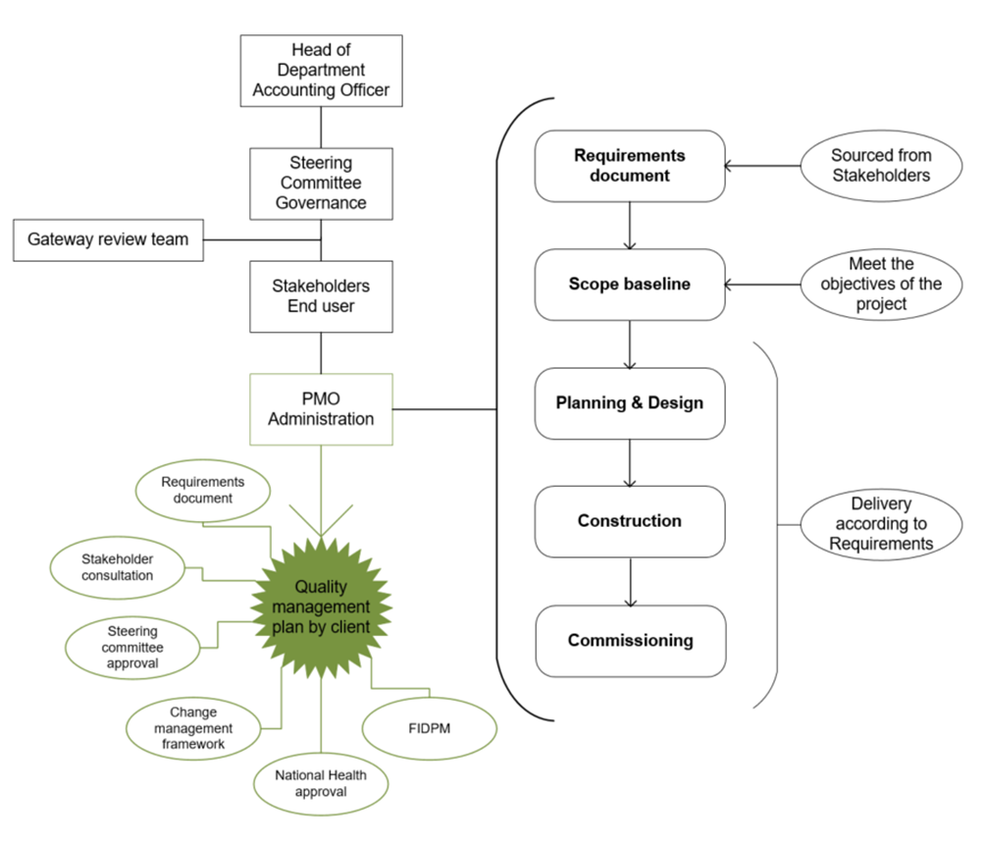
GROWING KWAZULU-NATAL TOGETHER
QUALITY MANAGEMENT

Slide 20
GROWING KWAZULU-NATAL TOGETHER
PRICING DATA
Pricing Assumptions
Basis of Remuneration, Method of Tendering and Estimated Fees
Remuneration for Professional Services
Value Based Fees
Set Off
Printing and Duplicating Work
Travelling and Subsistence Arrangements
Quality Management
Site Staff
Apportionment of Fees
Contract Skills Development Goal (CSDG)
Pricing Schedule

Slide 21
GROWING KWAZULU-NATAL TOGETHER
EVALUATION CRITERIA
The evaluation of bids will be conducted in three (3) phases:
Phase 1: Responsiveness
Correctness of bid document
Compliance with SCM regulations
Phase 2a: Eligibility Criteria
Minimum Key Persons assigned to the project
Proof of BIM (by Autodesk) Experience
Valid Professional Indemnity Insurance must be provided for each professional service
Phase 2b: Functionality Criteria
Experience of Key Persons
Past project experience of Key Persons
References for previous completed projects
Empowerment
Phase 3: Price and Preference Points

Slide 22
GROWING KWAZULU-NATAL TOGETHER
Planning and Programming
PSP Deliverables according to Construction Work Stages | Duration to produce deliverables for each stage
Stage 1: Inception Report | 1 month
Stage 2: Concept & Feasibility Report | 8 months
Stage 3: Design Development Report | 14 months
Stage 4: Design Documentation Report / Documentation & Procurement | 6 months
Stage 5: Works | 54 months
Stage 6: Project Close Out | 12 months
TOTAL TIME TO PRODUCE DELIVERABLES | 95 months

Slide 23


THANK YOU

